Slide 1
Uploading Files to Agency Web Useful tips – a guide

Slide 2
Uploading files to Agency Web allows authorized users to perform only the following tasks:
Upload General ledger transactions (transfers)
Upload warrant information to both Bank and dynamics
Upload revenue files to capture deposits in a timely manner
*Note: Warrant maintenance tasks are NOT performed in Agency Web.

Slide 3
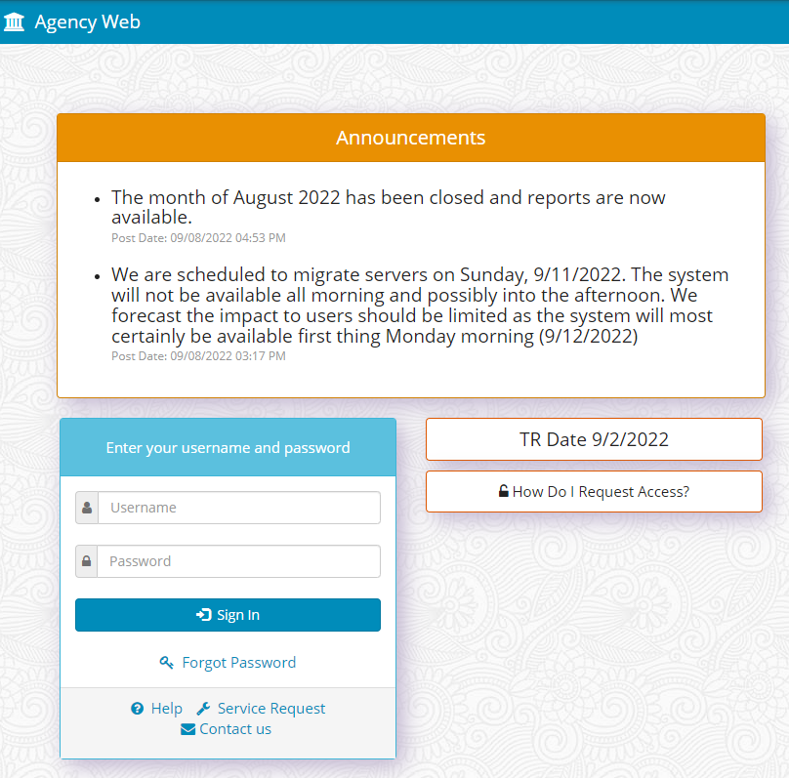
Requesting Permission for Upload Capability

Slide 4
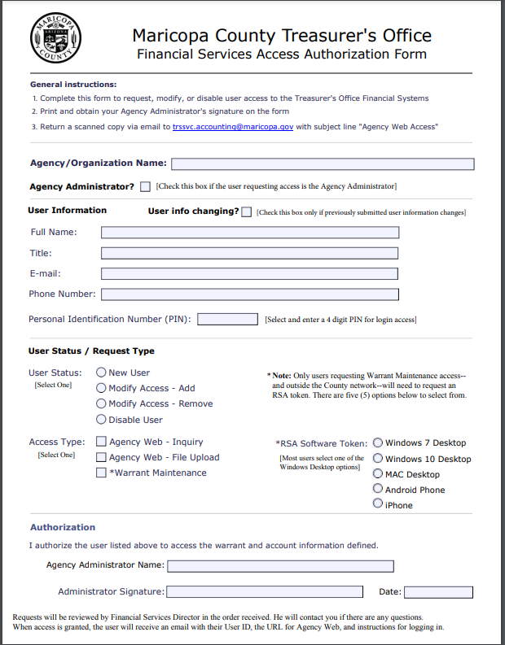
This form may be downloaded from Agency Web at any time
If you have trouble submitting this request, send an email to the following: trssvc.Accounting@maricopa.gov

Slide 5
Basic uploading information
Users can only upload files for the Agency to which they have been authorized. (per the Access form)
Users may be restricted in terms of what type of file they can upload. (i.e., only warrant files, etc.)
Uploaded files will undergo a series of validations by the system which will verify the file type, the data and your permissions.
The only acceptable file format is CSV – for all uploads.
Templates for 3 types of uploads are provided on the File Import tab
There are different rules for County Agencies and School Districts in terms of who uploads the file:
**CSS= County Schools Superintendent’s Office
Who Prepares the File | Who Uploads the File Type
Agency Type | General Ledger | Warrant | Revenue
County Agency | County Finance | County Finance | Agency
County School District | CSS | CSS | CSS
Independent School District | Independent SD | Independent SD | Independent SD
Other Districts | District | District | District

Slide 6
template requirements
TXT field (sample-column H) is your desired description (60 characters max) This field may be useful if performing a search after posting is complete.
Must be saved as CSV. Any attempt to upload an Excel file will result in a failure message.
Transdate field (sample- column F) must be formatted as MM/DD/YYYY. All other fields are unformatted.
Template will not total your columns – you must do this manually to ensure amounts agree to your deposit. If you add a formula to this spreadsheet, you must delete the lines with the formula before uploading.
No blank lines are allowed (failure) as well as no lines with a “zero” as an amount. (failure)
Most Revenue files will be credits – but debits are allowed (just not on the same line.
First four columns must remain blank.

Slide 7
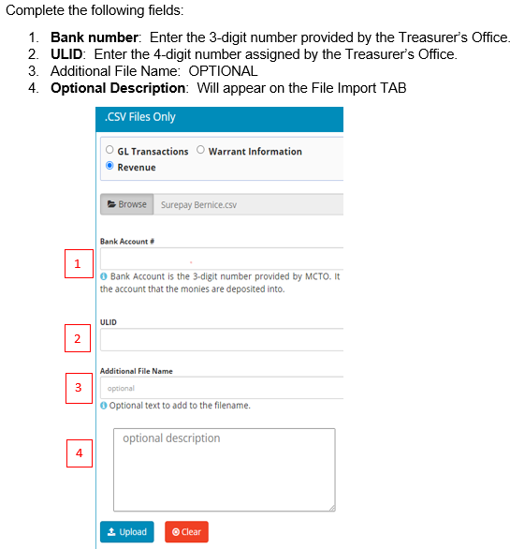
Uploading Revenue Files
Ensure you have selected the correct option (button)
Do not combine separate deposits into one file.
Do not split one deposit into multiple files.
Immediately after a deposit is made at the bank, the agency should prepare a csv file for upload purposes. The total amount in the file should agree EXACTLY to the deposit made at the bank.
Users must enter their corresponding ULID and Bank numbers at the beginning of the upload process.
Do not backdate your revenue file to a closed accounting period

Slide 8
Uploading Revenue Files (cont.)
County Agencies: prepare your revenue files using a custom-built input Excel form provided by County Finance.
Template ensures proper account coding translations to the Advantage System
County Agencies should contact Harry Baughman with questions or for templates. Harry.Baughman@maricopa.gov
County School Districts: prepare your revenue files and forward them to the County Schools Superintendent’s Office (CSS) for upload.
Independent School Districts: prepare and upload your revenue files following template guidelines provided.
File names are automatically changed by the system during the upload process.
Users will receive either a Success or Failure message via email and on screen at the File Import tab. All lines will succeed or fail. (no partial uploads for Revenue files)
Do Not re-upload the same file twice UNLESS and UNTIL you receive an error message.

Slide 9
Uploading Revenue Files (cont.)
Success message indicates:
File has been loaded to the Revenue Clearing account in Dynamics only.
File has NOT been posted to the Agency’s account at this point.
MCTO will post the deposit to each Agency’s account when working on that particular “TR Date”.
Agencies can check the TR Date on the home page of Agency Web. (usually there is a 2-3 day lag)
MCTO will post the deposit to the Agency’s account using the date on the uploaded file. (unless the accounting period is closed).
Failure message:
User should review the error log received via email which will indicate the line number and what type of error was encountered.
If the deposit is made at the bank in a period which has since closed, and the file is uploaded later, the agency must use a date in the current open period.
Correct the errors and re-upload the entire file.

Slide 10
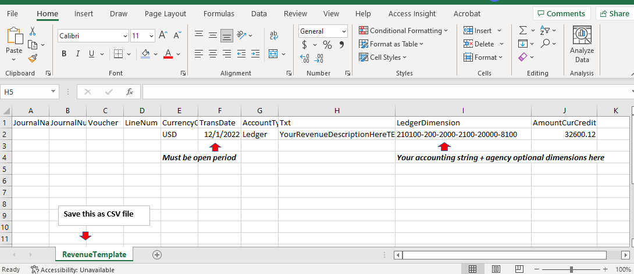
Sample Revenue Template

Slide 11
Uploading GL files (aka transfers)
Ensure you have selected the “GL Transactions” button.
If you do not select the correct button, you will receive a “conversion error” message.
Browse your computer to select the proper CSV file for upload.
In a few seconds, you should see the file detail added to the top of the list of files processed:

Slide 12
Uploading GL files (aka transfers cont.)
Watch your email for a success or failure message.
Every line in the GL file must be valid to post successfully. If any line has an error, the entire file will fail – the entire file must be re-uploaded once the errors are corrected.
Ensure that debits = credits, you will receive an error message if they do not balance.
A “success” message indicates the entry has been posted to the Accounting system and will appear in Agency Web activity the next business day.
All templates are located within the “file upload” tab of Agency Web.

Slide 13
Uploading Warrant Files
Select the correct button, in this case: “Warrant Information”
Selecting the wrong button will result in a “Conversion Error”.
Click the browse button to find and select the CSV warrant file you want to upload from your computer.
After a few seconds you will see the file detail added to the top of the list of files processed.

Slide 14
Uploading warrant files (cont.)
Watch your email for a success or failure message.
Remember, warrant files CAN be partially successful. Valid lines will post and only the invalid lines will fail.
The “Error Log” will tell you which lines failed. Only re-upload the lines that failed!
Best practice is to upload the warrant file as soon as you print your warrants. The Bank will not pay a warrant presented in person at the branch if the file has not been uploaded.
Warrants will appear in Agency Web with a status of “issued” the next business day after upload.
Templates can be found on the file upload tab.
Warrant maintenance cannot be performed in Agency Web. Users must submit a change form to the Accounting inbox: trssvc.Accounting@maricopa.gov
If you need to check the status of warrant, go to the warrant inquiry tab.

